Slide 1

JSMC Facility Services Pvt. Ltd.
www.jsmcservice.com
JSMC Facility Service Pvt. Ltd.
A709-710 GD Colony,
Mayur Vihar Phase III, Delhi 110096.
Telephone: +(91)-(120)-4358661
Phone : +(91) - 9811242347 & +(91) - 9560150555

Slide 2
JSMC Genesis
The JSMC Facility Services Pvt. Ltd. has been synonymous with quality and assurance since 2005.
Over the last 10 Years JSMC Facility Services Pvt. Ltd. has emerged as a Complete Facility Management Services Company with various divisions.
With its North India Operations JSMC has achieved a regional status with its business model and Service Level at par with the Global Standards.
We employ over 225 employees.

Slide 3
General Profile
Backed by a talented team and our industry excellence, we are able to provide most bountiful and prolific solutions to our clients. Our flexible services meet the ever rising market demands and clients' expectations. The distinguished services that we offer are Man power supply, Carpets and chairs Cleaning, Pantry services, Office support services, Security services and Machined cleaning.
Our services are executed with the help of industry professionals and experts, who ensure that timely completion and cost-effectiveness are the two most important aspects a service provider should fulfill.
Our industrial proficiency allows us to effectively meet the clients' demands, be it in a commercial environment or industrial space. Our team executes the projects in accordance with the needs and requirement of customers.

Slide 4
Services Package
Type of Properties
Commercial space and property
Estate management
IT Parks
Township Management
Residential
Facility Management Services
Housekeeping Services
Pantry
Carpet and Chair Shampooing
Guest House Management
Pest Control
Office Support Staffing
Residence Maintenance

Slide 5

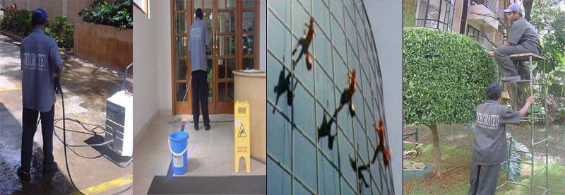

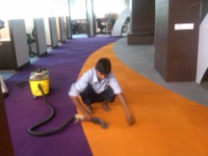
FM Scope of Services
Environmental Services
Housekeeping
Pest Control
Facade Management
Pantry Services
Carpet & Chair Shampooing

Slide 6
Facilities Mgt Org and Brief Responsibilities
House Executives – Offices & Factories
Over all in Charge
Coord activity of all Facilities & Supervisors
Coord with Management Daily
Ensure Daily, Weekly, Monthly Schedule executed of all Facilities.
Coord daily Waste management.
Conduct Daily Work Audit of all facility as per detailed work schedule.
Cood work of Plumbers , Electricians for Offices Residential Homes , Condominiums
Housekeeping
1. Ensure all jobs done as per Schedule.
2. Ensure that weekly jobs are undertaken.
3. Ensure Spot cleaning and Dry Cleaning of Carpets, Sofas and Chairs.
Internal Performance Monitoring by Internal Auditors from JSMC

Slide 7
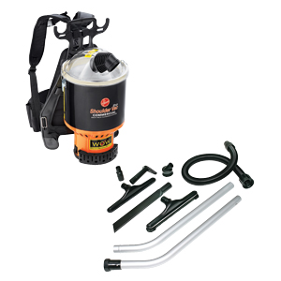
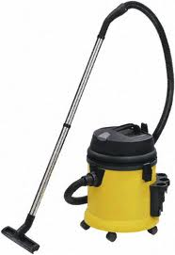
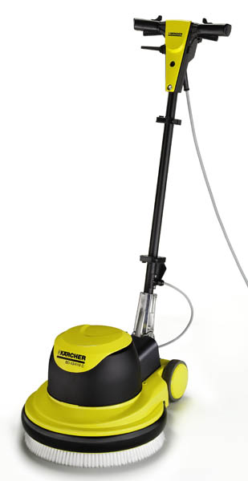

Charges for Material , Machine Rentals & Machine Consumable
(a) Machine we will use - when deployed
* Floor Scrubbing and Polishing Machines.
Buffing & Crystallization Machine with
Diamond Pads.
* Burnishing Machine.
* Shampoo Machines.
* Wet & Dry Vacuum Cleaners
* Hi pressure jets

Slide 8
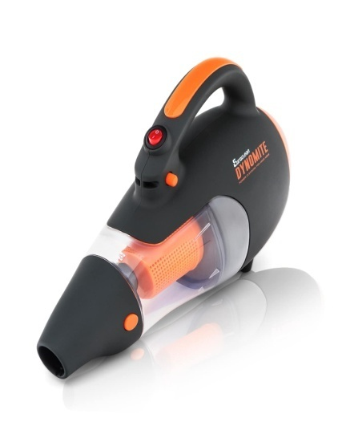
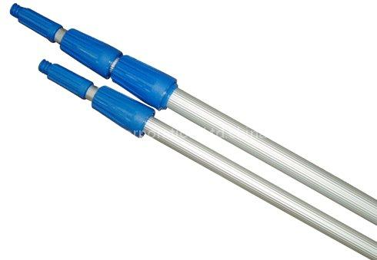
Material we will use :-
* Window cleaning kit including Telescopic poles. Ladders to be provided by the client wherever suspended trolley is not available
* Communication and Computer Cleaning Material.
* Modern Floor Cleaning Material.
* Cleaning Material for:- Various types of Floors
like Marble , Granite , Tiles etc .
* Office Interiors including Work Stations, Furniture.
* Curtain and Door Glass panels.
* Toilet Cleaning Material.
* Ph Neutral Chemicals for expensive Floor Cleaning.
* Rest Room Items like Naphthalene balls, Harpic etc.

Slide 9
Carpets and chairs Cleaning
The best way to rid your carpets of these invisible but deadly oily particles is to have your carpets steam cleaned by professional steam cleaning services at least once every 12 to 18 months. Steam cleaning services are an affordable, worthwhile investment. Enlist the help of professionals who clean for a living and are experts on topics like carpet shampoos, steam cleaning equipment and different kinds of oily soil deposits.
steam cleaning service professionals will know exactly how to best clean your particular carpet, taking into consideration its make, its state and the kind of pollutants to which it is exposed. Then, the professionals will steam clean your carpet so well that you won't have to worry about it for at least a year. Steam cleaning services are a wonderful (and necessary! ) treatment for your home. The steam cleaning service that arrives at your home will use some kind of hot water extraction system.

Slide 10
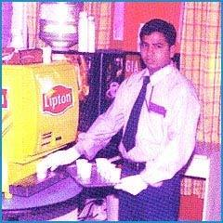
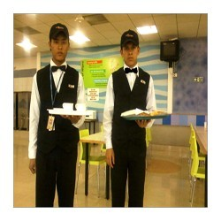
Pantry Services
We also offer our customers pantry services that include serving of snacks to our customers. These pantry services of experienced industry professionals also allow us to better manage places like guest houses, where our staff can be placed 24 hours a day. Some of the work are as we provide our services for include: daily cleaning Arranging of plates Doing errand jobs for the guests Overall maintaining a good hygiene level in the guest house, thus making the long stay of the guests more comfortable

Slide 11
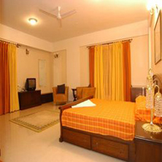
Guest House Management Services
HOSPITALITY:
Receiving notification of expected arrivals.
Preparation of the rooms.
Welcoming the guests & making their stay comfortable.
Arranging for their Food and Beverage requirement.
Arranging for their Food and Beverage requirement.
Preparing & submitting Room Occupancy Report.
DAILY HOUSEKEEPING:
Daily cleaning of all rooms & common areas of the property.
Servicing of guest rooms.
Servicing of toilets.

Slide 12
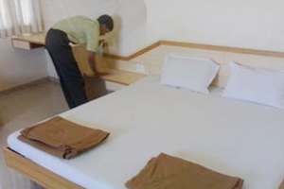
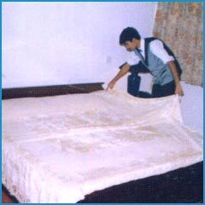
Guest House Management Services…Contd.
HOSPITALITY: Receiving notification of expected arrivals. Preparation of the rooms. Welcoming the guests & making their stay comfortable. Arranging for their Food and Beverage requirement. Arranging for their Food and Beverage requirement. Preparing & submitting Room Occupancy Report. DAILY HOUSEKEEPING: Daily cleaning of all rooms & common areas of the property. Servicing of guest rooms. Servicing of toilets.

Slide 13
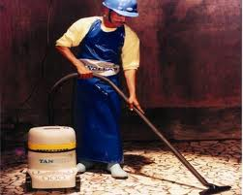
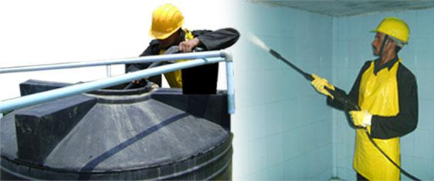
Water Tank Cleaning and Disinfection
Service
JSMC Facility Services Pvt. Ltd. is a safe and scientific solution to clean and disinfect storage water tanks that involve a 6 stage cleaning process using state-of-the-art imported equipment and proprietary antibacterial agents that are safe, effective and eco-friendly. As compared to conventional tank cleaning, JSMC ensures faster tank cleaning for even the most neglected tanks.
The entire process takes just 45 minutes of cleaning time which keeps the tanks safe and healthy for the next 90 days. Fully trained staff with access to hygienic and safety equipment and maintenance of systematic service records ensures complete peace of mind to the end consumer.

Slide 14
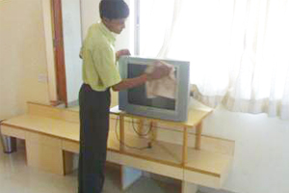

Guest House Management Services…Contd.
SPRING CLEANING ON SATURDAYS:
Cleaning of Lights & A/c vents, fans, lights, panel strips, artifacts if any.
Polishing of brass and steal panel strips and knobs.
Special cleaning of uncarpeted floor area.
Disinfectant treatment of toilets, water closets and wash basins.
Sponging off wall stains.
Polishing telephone instruments.
Thorough cleaning of the refrigerators and underneath & behind all movable furniture.

Slide 15
Selection and Registration
Selection Procedure- Correct selection of Manpower is a first step towards quality control that we at JSMC are so conscious about . A full time Director looks into these aspects of Personnel Management . Selection procedure includes:-
Police Verification.
Medical Examination.
Documentation including registration for PF, ESI.

Slide 16
Documentation
Appointment Letter.
Terms and Condition form of our company duly signed by
the individual.
Photo Identity Card of our Company.
ESI Card applied for within 10 days.
Attendance Register and attendance slip signed daily by our
workers.
Application for Labor License once Form V received
from you when the workforce size becomes 20 or
above .

Slide 17
Training of staff
Nothing can be more important than this very crucial aspects of the Service industry . We at JSMC lay a great emphasis on this particular aspect of Man Management . Our Training Programme follows the under mentioned structured format:
Basic Format - This is done at the time of Recruitment of Personnel even if they are experienced to make them aware of the quality of work required in various sites .
Pre deployment Capsule - This is based on the specific requirement of each new site where the Manpower is required to be deployed .
Refresher Capsule - This is location specific and Aims at preventing casualness which may set in amongst the staff . This is done Bi- Monthly .

Slide 18
Registers Maintained
Wages Register.
Wages Slip.
PF Contribution.
ESI Contribution.
EL Register.
Fine Register.
Overtime Register.
Form 6 , 3 ,32 , Eligibility Register for ESI Contribution .
Form 6A, 3 A (Revised) Eligibility Register for PF Contribution.

Slide 19
What We Will Charge
Charges for Manpower deployed (Twenty Six days – 8 Hours per day)
Salary of all Supervisors.
Salary of all workers as negotiated.
ESIC Payment.
PF Payment.
Bonus where applicable.
EL where applicable.
Charges for Uniforms.
Service Charges

Slide 20
Transition Module
TRANSITION MODULE - SPECIAL PROJECT & PROCESS MANAGER
The mandate:
Develop an Operations Manual specific to the clients requirements
Define all Processes
Create post specific post instructions
List out possible triggers, define a definite escalation process for each trigger
Develop Quality Standards & Measure
Build a score card process for evaluation & review of services
Coordinate with all levels within JSMC and client to ensure compliance

Slide 21
Transition Module (Cont…)
Before deployment
Ensure that post wise duties of all the posts are documented.
Aware of Specific and special instruction from client.
In house Training is conducted based on customized Post Instructions
3 days before takeover
Our respective operations people understand the systems & processes by being on-site.
1 day before deployment
Our entire guard force overlaps duty for a 24 hour shift

Slide 22
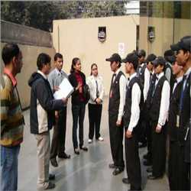
Transition Module (Cont…)
Post Deployment Management
Daily for 1st week
Training On site by Training Manager
Day & night Supervision
Daily visit by Operations Manager
Daily visit by Business Leader
Weekly review meeting
2nd Week-4th Week
Weekly training program by on site training manager
Day & night supervision
3 times a week visit by operations manager
Weekly review meeting

Slide 23









Testament of Success
In Over 15 years of operation, JSMC employs over 225 employees,, servicing MNC’s and ‘New Age Economy Businesses’ across various segments.
Notes:
23

Slide 24













Slide 25








Slide 26










Slide 27








Slide 28





Slide 29
Essential Company Details – Regn- U93000DL2011PTC215721
Permanent Account Number (PAN) : AACCJ5531A
GST Number : 07DUYPK2093A1ZE
E.P.F. Registration Number : DS/SHD/00034977/000/0000002
E.S.I. Registration Number : D/D1/INS-II/10000761570001001

Slide 30

Thank You

